Slide 1


Capstone Project - The Battle of Neighborhood (Week 1)
By: Charry Lam

Slide 2
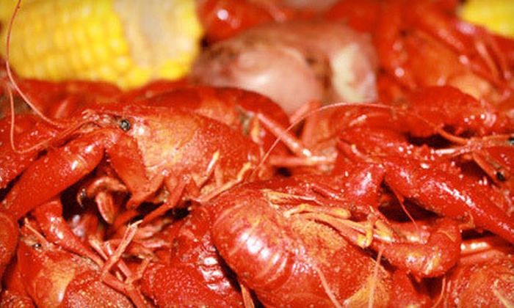

Introduction
With the endless selection of food you get in the small town Lafayette, the decision to choose where to go is ever more difficult. Lafayette is home to the University of Louisina known as the Rajun Cajun and many international student study abroad. With that information I would like to know which restaurant have the best rating in the neighborhood?

Slide 3
Business Challenge:
Using Foursquare API, I will cluster similar restaraunt together. Based on the output from foursquare, user can easily determine what type of restaurants are best to eat at based on feedback.

Slide 4
Data Requirements:
For this assignment, I will be utilizing the Foursquare API to pull the following location data on restaurants in Lafayette, Louisiana
Venue Name
Venue ID
Venue Location
Venue Category
Count of Likes

Slide 5
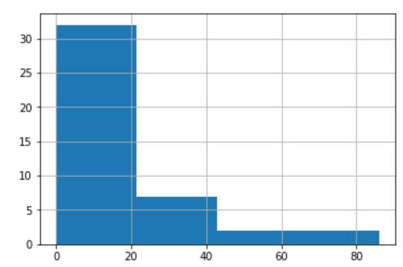
Histogram
let's visualize our total likes based on a histogram

Slide 6
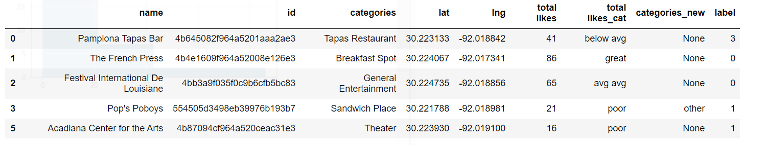
Top 5 Venue
Here are the top 5 Venues as you can see “The French Press” has the highest feedback.

Slide 7
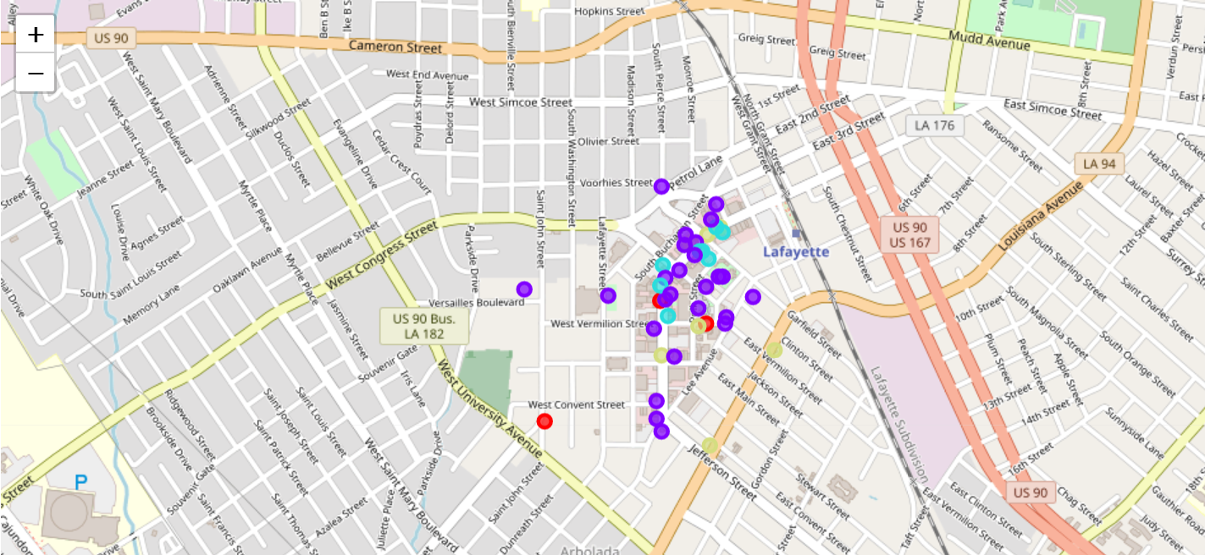
Location with Marker

Slide 8
Results / Conclusion
With the different restaurants in the area in Lafayette, based on the reviews the best place to eat would be "The French Press". There are many selections of venues around the area also, with the feedback Festival International De Louisiane" and "Johnson's Boucaniere" would also be a nice option to check out. All of the analysis is based on feedback from the number of feedback which would require higher feedback to recieve a higher ranking.
Notes:
In Slide Show mode, select the arrows to visit links.

